Slide 1


Slide 2
Defining Faith

Slide 3
1 Thes 3:1-5 Wherefore when we could no longer forbear, we thought it good to be left at Athens alone; 2 And sent Timotheus, our brother, and minister of God, and our fellowlabourer in the gospel of Christ, to establish you, and to comfort you concerning your faith: 3 That no man should be moved by these afflictions: for yourselves know that we are appointed thereunto. 4 For verily, when we were with you, we told you before that we should suffer tribulation; even as it came to pass, and ye know.5 For this cause, when I could no longer forbear, I sent to know your faith, lest by some means the tempter have tempted you, and our labour be in vain.

Slide 4
Eph 3:16-21 That he would grant you, according to the riches of his glory, to be strengthened with might by his Spirit in the inner man; 17That Christ may dwell in your hearts by faith; that ye, being rooted and grounded in love, 18 May be able to comprehend with all saints what is the breadth, and length, and depth, and height; 19 And to know the love of Christ, which passeth knowledge, that ye might be filled with all the fulness of God. 20 Now unto him that is able to do exceeding abundantly above all that we ask or think, according to the power that worketh in us, 21 Unto him be glory in the church by Christ Jesus throughout all ages, world without end. Amen.

Slide 5
BY FAITH
FOCUSING ON FAITH
  Point 1: Your faith is the most powerful thing that God has given you to use!
  Through your faith, (God’s power, His promises,) His Word is made REALITY in your life.

Slide 6
BY FAITH
FOCUSING ON FAITH
  Substance = “to support / the essence”
  Faith is “substance” of things HOPED for. It has weight. It is production.
  Bible definition: Hope, of things hoped for = these are expected things!
  Evidence = “proof”

Slide 7
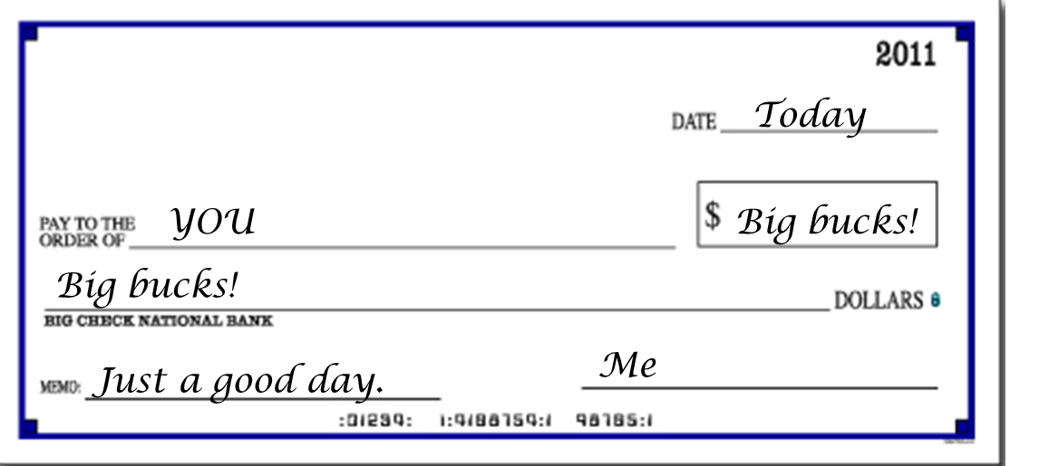
Add Text

Slide 8
BY FAITH
FOCUSING ON FAITH
  Substance = “to support / the essence”
  Faith is “substance” of things HOPED for. It has weight. It is production.
  Bible definition: Hope, of things hoped for = these are expected things!
  Evidence = “proof”
  Substance = “confidence”

Slide 9
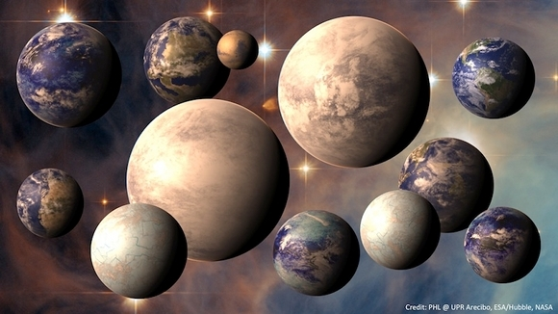
Add Text

Slide 10
John 1:1-3 In the beginning was the Word, and the Word was with God, and the Word was God. 2 The same was in the beginning with God. 3 All things were made by him; and without him was not any thing made that was made.
1Co 15:52 In a moment, in the twinkling of an eye, at the last trump: for the trumpet shall sound, and the dead shall be raised incorruptible, and we shall be changed.

Slide 11
BY FAITH
What science has discovered in recent years is that the atom is made up of a universe of particles.
And the smaller they reduce its components, (down to the levels of quantum and string theory) they find that it all has the
characteristics of what? SOUND.

Slide 12
Gen 1:1 In the beginning God created the heaven and the earth.
Gen 1:3 And God said, Let there be light: and there was light.

Slide 13
Col 1:12-17 Giving thanks unto the Father, which hath made us meet to be partakers of the inheritance of the saints in light: 13 Who hath delivered us from the power of darkness, and hath translated us into the kingdom of his dear Son: 14 In whom we have redemption through his blood, even the forgiveness of sins: 15 Who is the image of the invisible God, the firstborn of every creature: 16 For by him were all things created, that are in heaven, and that are in earth, visible and invisible, whether they be thrones, or dominions, or principalities, or powers: all things were created by him, and for him: 17 And he is before all things, and by him all things consist.

Slide 14
BY FAITH
Point 2: Physical reality was literally manifest by the Word of God.
Regardless what you may think – it cannot contradict its nature. It consists by the very word of God.
AND SO…You MUST DO THE SAME!
Point 3: Your belief in God’s word determines your personal reality before God.

Slide 15
All faith is…
is taking God at His Word!

Slide 16
Rom 3:4 God forbid: yea, let God be true, but every man a liar; as it is written, That thou mightest be justified in thy sayings, and mightest overcome when thou art judged.
Deut 32:20 And he said, I will hide my face from them, I will see what their end shall be: for they are a very froward generation, children in whom is no faith.

Slide 17
Faithlessness is why you
CANNOT see God in your life!
Your world view is in direct conflict with the truth of
God’s word. Unbelief doesn’t
make the Word wrong

Slide 18
Rom 10:13-17 For whosoever shall call upon the name of the Lord shall be saved. (14) How then shall they call on him in whom they have not believed? and how shall they believe in him of whom they have not heard? and how shall they hear without a preacher? (15) And how shall they preach, except they be sent? as it is written, How beautiful are the feet of them that preach the gospel of peace, and bring glad tidings of good things! (16) But they have not all obeyed the gospel. For Esaias saith, Lord, who hath believed our report? (17) So then faith cometh by hearing, and hearing by the word of God.

Slide 19
Act 4:12 Neither is there salvation in any other: for there is none other name under heaven given among men, whereby we must be saved.

Slide 20
Rom 10:8-11 But what saith it? The word is nigh thee, even in thy mouth, and in thy heart: that is, the word of faith, which we preach; (9) That if thou shalt confess with thy mouth the Lord Jesus, and shalt believe in thine heart that God hath raised him from the dead, thou shalt be saved. (10) For with the heart man believeth unto righteousness; and with the mouth confession is made unto salvation. (11) For the scripture saith, Whosoever believeth on him shall not be ashamed.

Slide 21
Eph 2:8 For by grace are ye saved through faith; and that not of yourselves: it is the gift of God:

Slide 22
BY FAITH
FINAL APPLICATION
  You were saved through faith. Eph 2:8-9
  Unless you believed the Gospel you could not receive Christ’s salvation.
  What was true at salvation is true for every day since. You have to live your life according to faith in God’s Word. Why?
  Your faith is directly TIED to your reality (to the fulfillment of His promises in your life!)

Slide 23
Mat 14:28-33 And Peter answered him and said, Lord, if it be thou, bid me come unto thee on the water. (29) And he said, Come. And when Peter was come down out of the ship, he walked on the water, to go to Jesus. (30) But when he saw the wind boisterous, he was afraid; and beginning to sink, he cried, saying, Lord, save me. (31) And immediately Jesus stretched forth his hand, and caught him, and said unto him, O thou of little faith, wherefore didst thou doubt? (32) And when they were come into the ship, the wind ceased. (33) Then they that were in the ship came and worshipped him, saying, Of a truth thou art the Son of God.

Slide 24
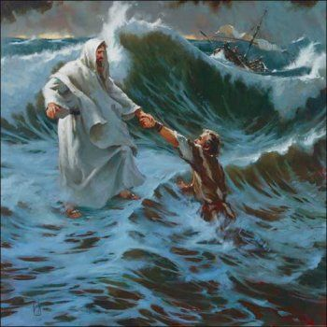

Slide 25
Heb 11:6 But without faith it is impossible to please him: for he that cometh to God must believe that he is, and that he is a rewarder of them that diligently seek him.
Heb 10:38 Now the just shall live by faith: but if any man draw back, my soul shall have no pleasure in him.

